Slide 1
Mini Project On Predicting Grade Of The House using Machine Learning Techniques
Manas Ghodke
DSFT8

Slide 2
Problem Statement or Business Problem
Property buyers have different requirements.
To facilitate this, real estate companies prefer categorizing various houses into different grades based on various parameters.
This would help agents in identifying the type of house a customer is looking for. This way, the search for the house can be narrowed down by focusing only on the ‘condition of the house’.
The Grade (condition of the house that ranges from A (Best) – E (Worst) ) can also be used by existing owners to list their properties for sale.
Grading helps them in arriving at a price of the house.

Slide 3
Business Objective
Build a predictive model to determine the Grade of house (The grades are A,B,C,D, and E)

Slide 4
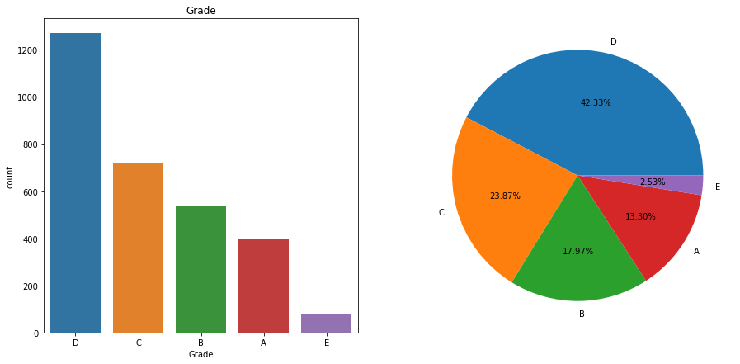
Analysis Of House Grade

Slide 5
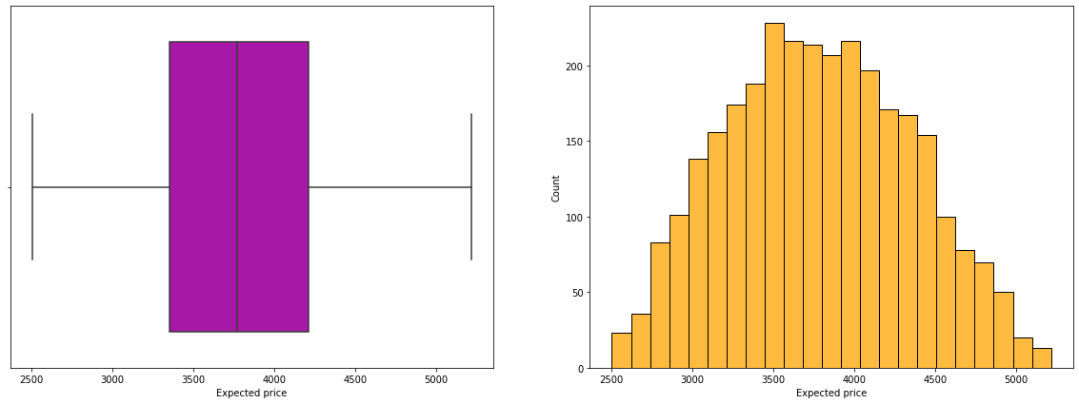
Analysis of expected price

Slide 6
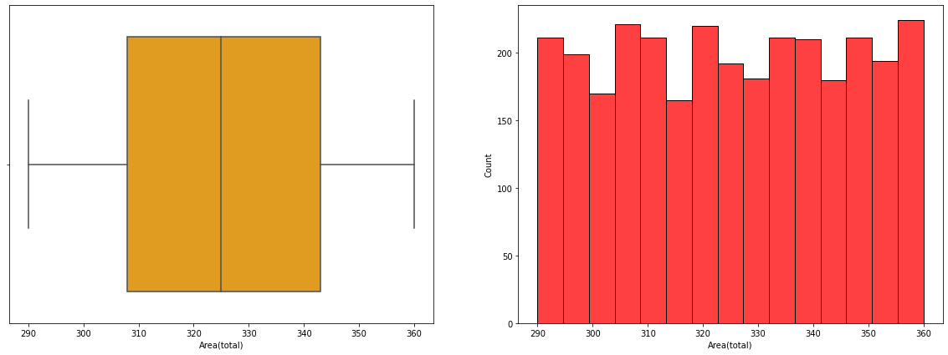
Analysis of area

Slide 7
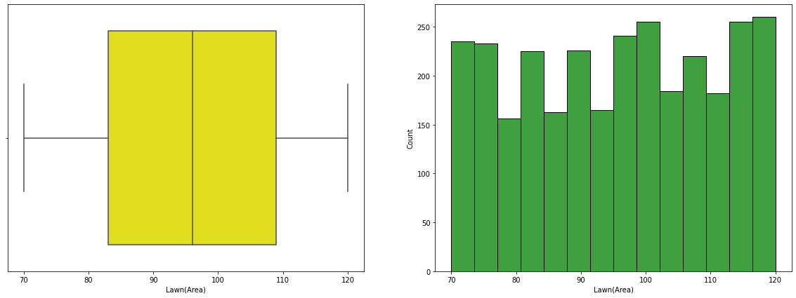
Analysis of lawn(Area)

Slide 8
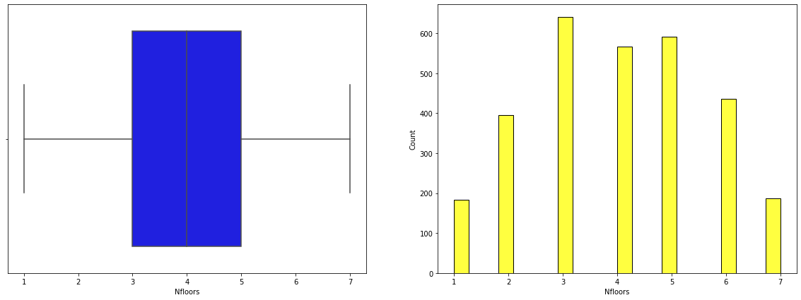
Analysis of Number of floors

Slide 9
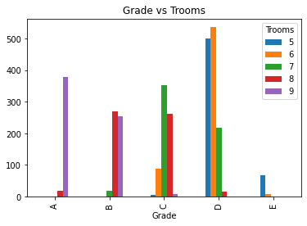
Analysis of Grade vs Trooms

Slide 10
Selection of Machine Learning Algorithms
We have selected Naïve Bayes Classifier Algorithm to train our model
Naive Bayes is simple, extremely fast, provides good results, is easy to implement in an IT production, is well suited when the training set does not fit in memory and is easy to explain in a regulatory industry. Naive Bayes is used for classification tasks (scoring, text & for imbalanced dataset) and it provides a good baseline for model comparison.
Naive Bayes are a group of supervised machine learning classification algorithms based on the Bayes theorem. It is a simple classification technique, but has high functionality. They find use when the dimensionality of the inputs is high. Complex classification problems can also be implemented by using Naive Bayes Classifier.
It is extremely fast due to the calculus to reach the decision’s probability for a class or another. It’s derived from the Bayes’ theorem in order to obtain a probability for each class. Then, the predicted class is the one having the highest probability (maximum a posteriori).

Slide 11
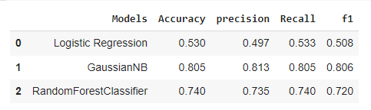
Results Of All Classification Algorithms
GaussianNB gives better results

Slide 12
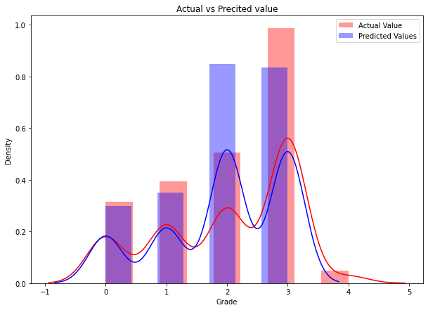
Actual vs Predicted values

Slide 13
Business Conclusion
From the analysis we have come to the conclusion that most of the houses belong to D grade category.

